Slide 1



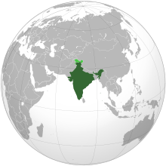


INDIAN CONSTITUTION

Slide 2
Judiciary
The judiciary is that branch of the government that interprets law, settles disputes and administers justice to all citizens.
The judiciary is considered the watchdog of democracy, and also the guardian of the Constitution.
For democracy to function effectively, it is imperative to have an impartial and independent judiciary.

Slide 3
Independent judiciary
It means that the other branches of the government, namely, the executive and the legislature, does not interfere with the judiciary’s functioning.
The judiciary’s decision is respected and not interfered with by the other organs.
It also means that judges can perform their duties without fear or favour.
Independence of the judiciary also does not mean that the judiciary functions arbitrarily and without any accountability.
It is accountable to the Constitution of the country

Slide 4
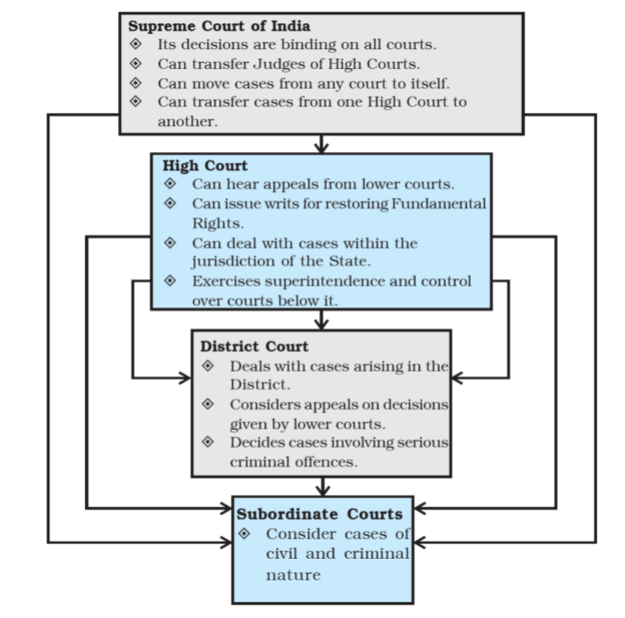
Judiciary Structure

Slide 5
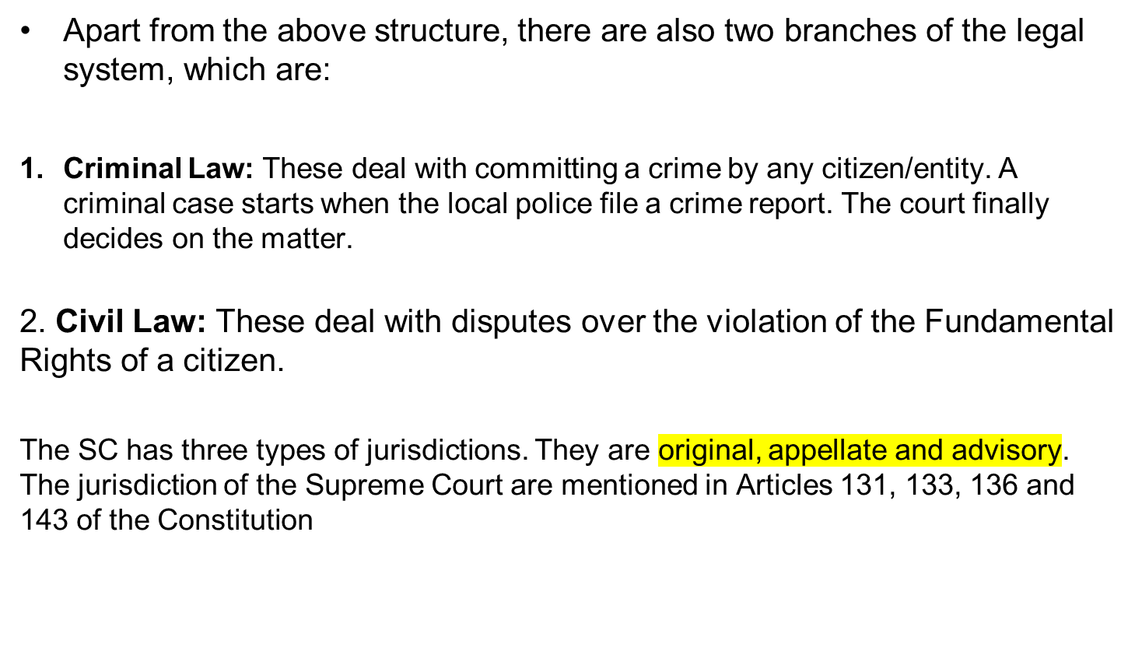
Articles

Slide 6
Administration of justice:
The chief function of the judiciary is to apply the law to specific cases or in settling disputes.
When a dispute is brought before the courts it ‘determines the facts’ involved through evidence presented by the contestants.
The law then proceeds to decide what law is applicable to the case and applies it. If someone is found guilty of violating the law in the course of the trial, the court will impose a penalty on the guilty person

Slide 7
Creation of judge-case law:
In many cases, the judges are not able to, or find it difficult to select the appropriate law for application.
In such cases, the judges decide what the appropriate law is on the basis of their wisdom and common sense.
In doing so, judges have built up a great body of ‘judge-made law’ or ‘case law.’ As per the doctrine of ‘stare decisis’, the previous decisions of judges are generally regarded as binding on later judges in similar cases.

Slide 8
Guardian of the Constitution:
The highest court in India, the SC, acts as the guardian of the Constitution. The conflicts of jurisdiction between the central government and the state governments or between the legislature and the executive are decided by the court.
Any law or executive order which violates any provision of the constitution is declared unconstitutional or null and void by the judiciary. This is called ‘judicial review.’
Judicial review has the merit of guaranteeing the fundamental rights of individuals and ensuring a balance between the union and the units in a federal state.

Slide 9
Protector of Fundamental Rights:
The judiciary ensures that people’s rights are not trampled upon by the State or any other agency.
The superior courts enforce Fundamental Rights by issuing writs.

Slide 10
Supervisory functions:
The higher courts also perform the function of supervising the subordinate courts in India.

Slide 11
Advisory functions:
The SC in India performs an advisory function as well. It can give its advisory opinions on constitutional questions. This is done in the absence of disputes and when the executive so desires.

Slide 12
Administrative functions:
Some functions of the courts are non-judicial or administrative in nature.
The courts may grant certain licenses, administer the estates (property) of deceased persons and appoint receivers.
They register marriages, appoint guardians of minor children and lunatics.

Slide 13
Special role in a federation:
In a federal system like India’s, the judiciary also performs the important task of settling disputes between the center and states. It also acts as an arbiter of disputes between states.

Slide 14
Conducting judicial enquiries:
Judges normally are called to head commissions that enquire into cases of errors or omissions on the part of public servants.

Slide 15
-THANK YOU-

